Slide 1
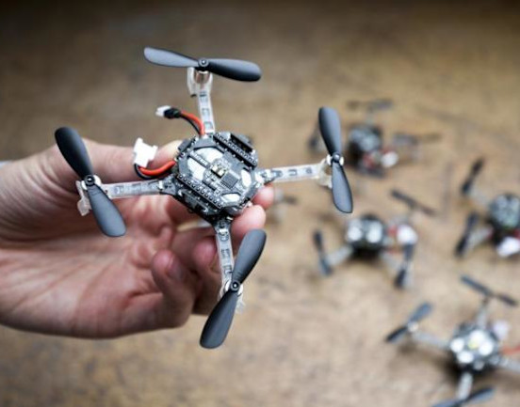
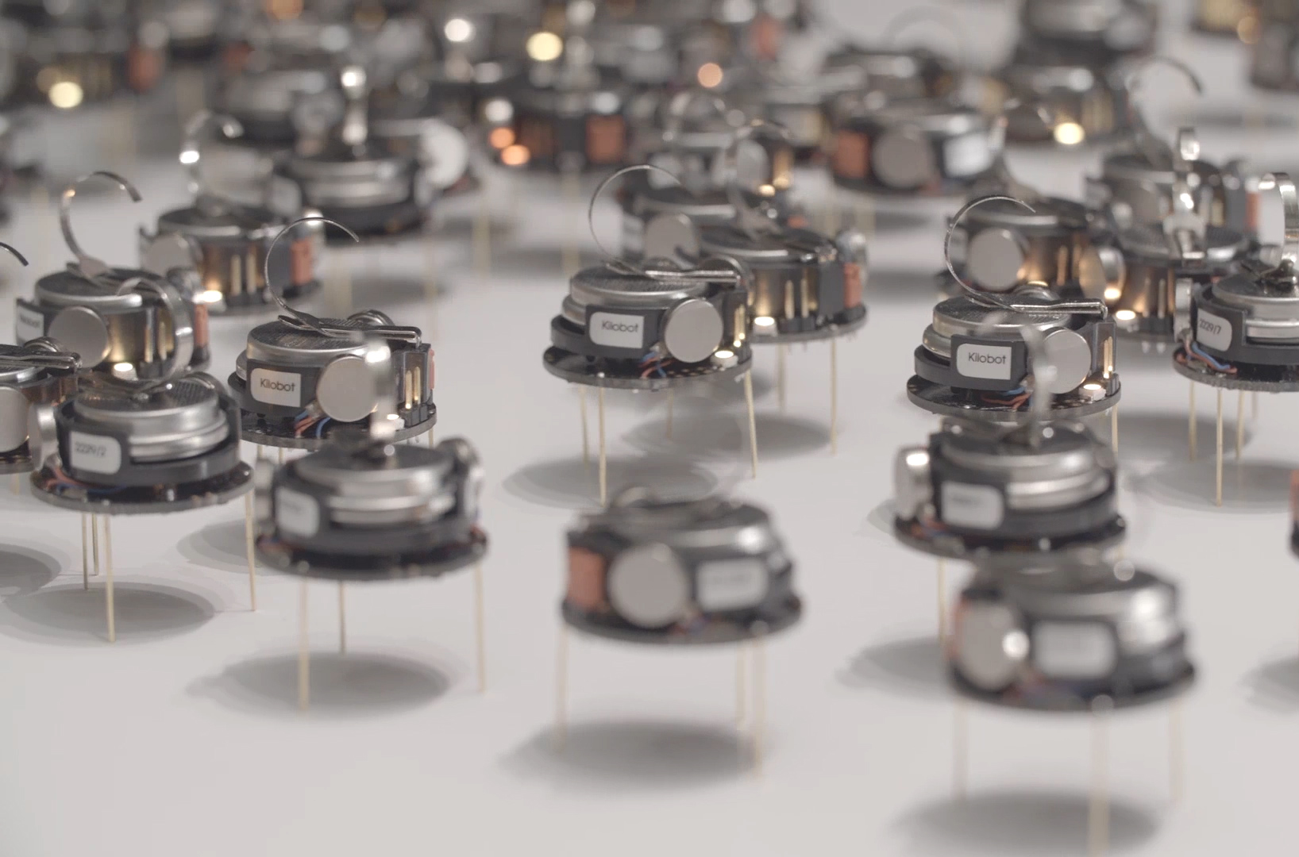
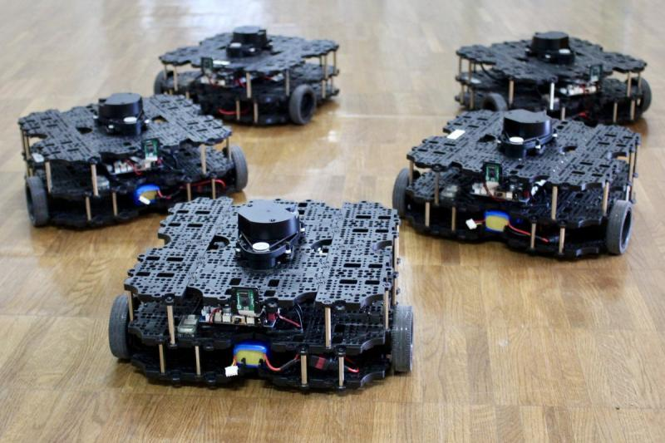

ECE693H, Spring 2025: Multi-robot System Design
“Autonomous Mobile Robots”
Dr. Daniel Drew

Slide 2
Multi-robot Systems

Slide 3
Pillars of Robotics
Action, perception, intelligence

Slide 4
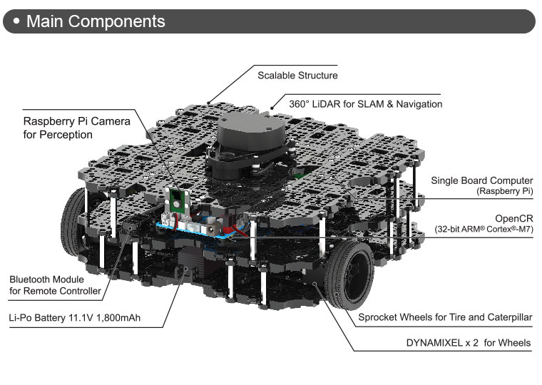
Case Study: The Turtlebot
Turtlebots

Slide 5
Case Study: The Turtlebot
Mobility base, kinematic model, how you command it to move

Slide 6
Case Study: The Turtlebot
Perception system: Pi camera, LiDAR puck

Slide 7
Case Study: The Turtlebot
Intelligence: Compute resources, advanced planning

Slide 8
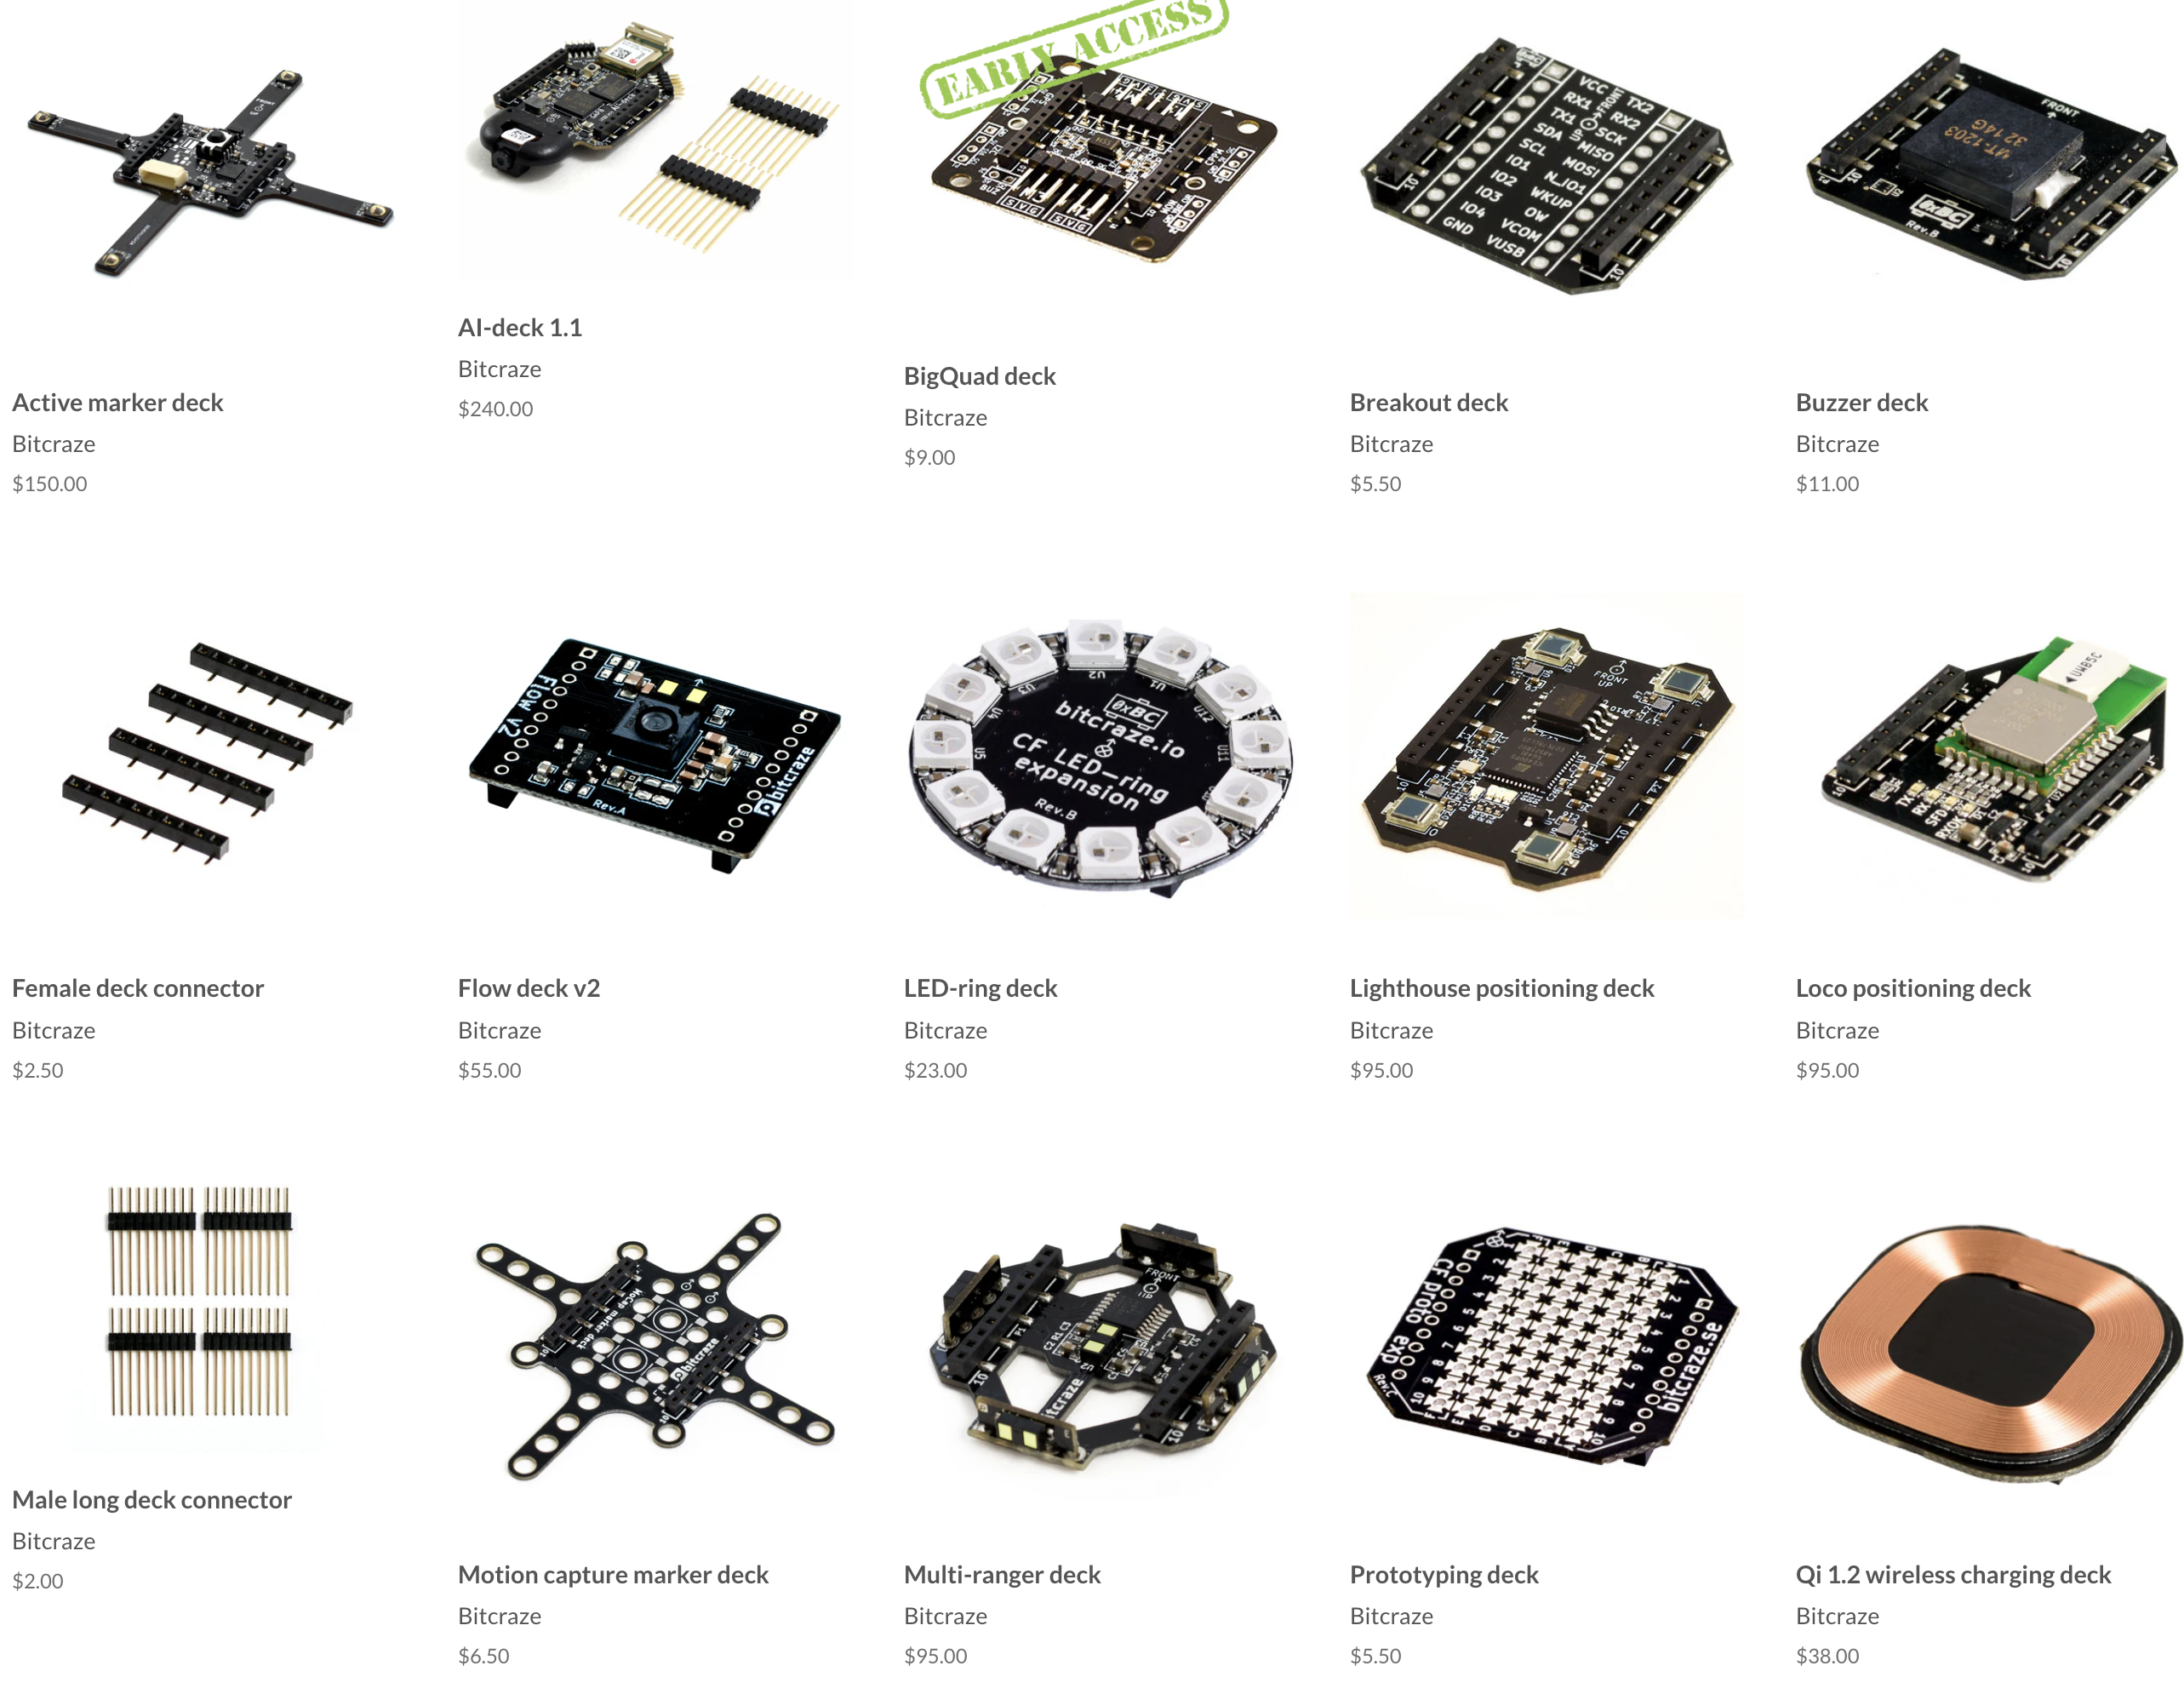
Case Study: The Crazyflie
Crazyflies

Slide 9
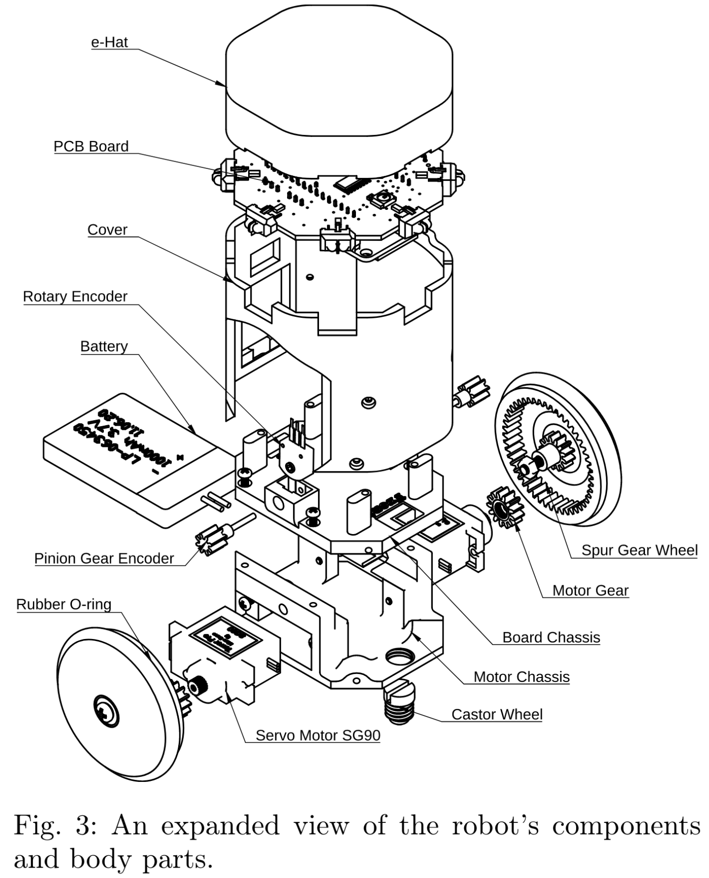
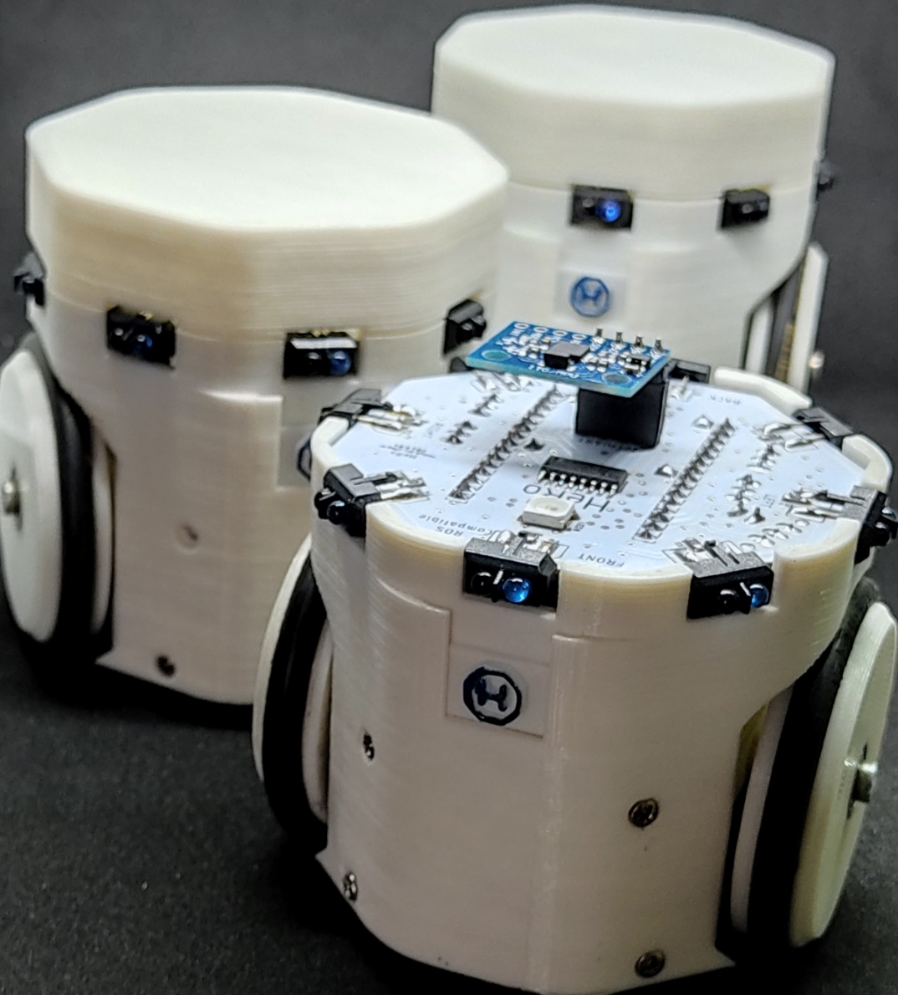
Case Study: The HeRo
HeRos
Rezeck et al. 2022

Slide 10

Swarm-on-a-Stick
We will create an open-source swarm robotics kit for education, from scratch.

Slide 11
693H Robotic Subsystems
Mobility
Perception
Compute and Power
Control and Planning

Slide 12
Subsystem Group Formation
Form groups of 4 or 5 for each of the four subsystems:
Mobility, Perception, Compute and Power, Control and Planning
Suggestions:
Interested in more coding?
Control and Planning
Interested in more mechanical design?
Mobility
Interested in more challenging pcb layout?
Perception, Compute and Power
To do today:
Send me an email (one per group): subject: [693H] Mobility Group, body: your names, at least one time you have each blocked off to work per week, and how your group will primarily communicate with each other (e.g., discord, email).

Slide 13
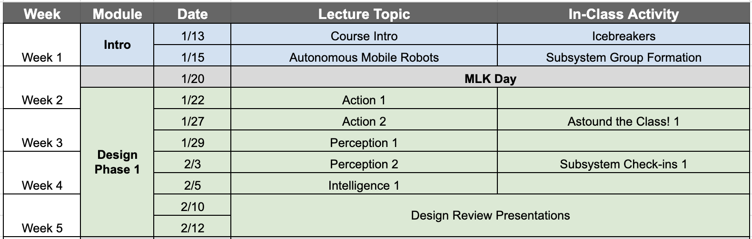
Course Schedule Reminder
Readings, tasks

